Slide 1






Medical
Logistic
Finance
Help-Desk
E-Government
Manufacturing
Sales & Marketing
Service Management
Fleet Management
Human Capital Management
Scope

Slide 2
Supply Chain Management

Slide 3
Finance Management

Slide 4
Sales And Marketing

Slide 5
Point Of Sale

Slide 6
Manufacturing

Slide 7
Quality Management

Slide 8
Human Capital Management

Slide 9
Help Desk Management

Slide 10
Fleet Management

Slide 11
Service Management

Slide 12
Judicial Management

Slide 13
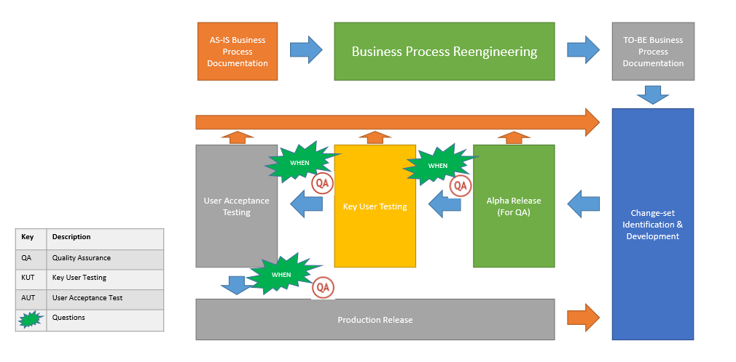
Implementation Strategy

